Slide 1




Sliced Data Migration Toolbox (SDMT) - Public
Meinrad Weiss Senior Cloud Solution Architect Microsoft

Slide 2




Transfer Scenarios
Direct transfer
Transfer via Data Lake (House)
SQL -> SQL
SQL -> Data Lake (House)
SQL -> Data lake -> SQL
SQL -> ADX, Fabric KQL Database
ADX -> Data Lake (House)
SQL -> Data lake (House) -> Fabric KQL Database
SQL -> Data Lake (House)
ADX -> Fabric KQL Database
SQL -> Data Lake (House) -> Fabric KQL Database

Slide 3
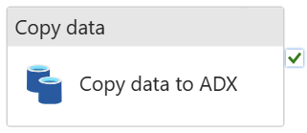
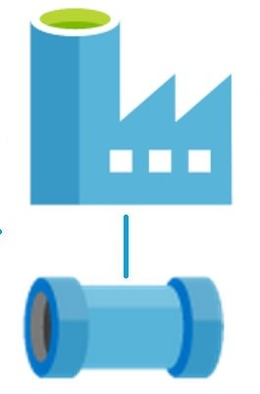
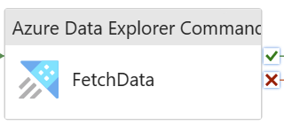
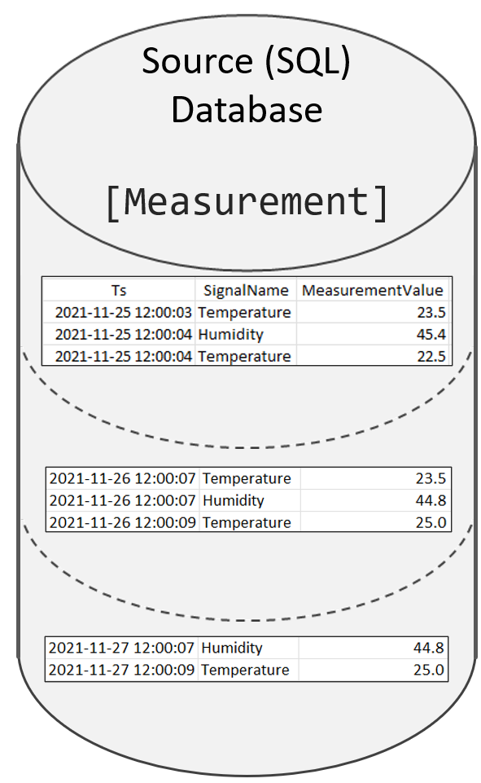
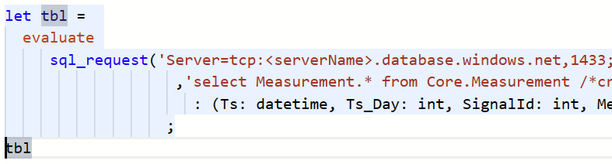
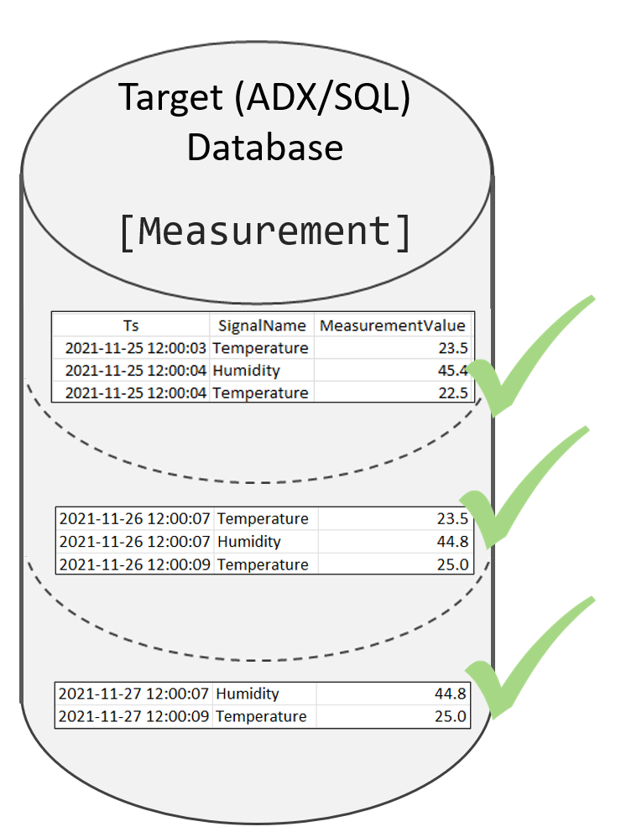
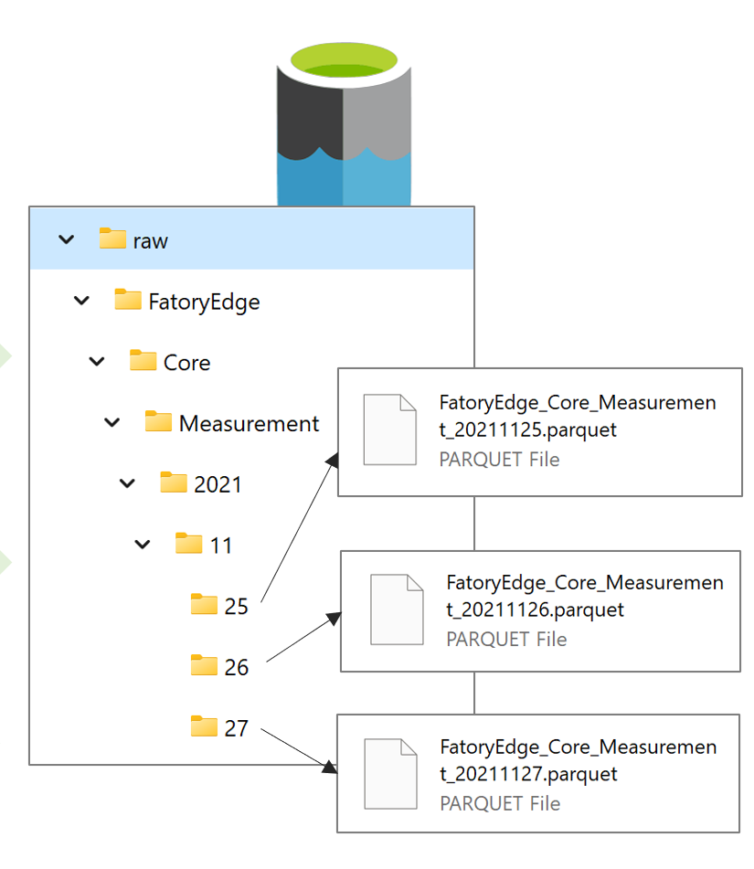
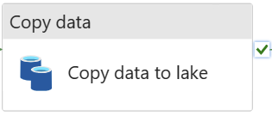
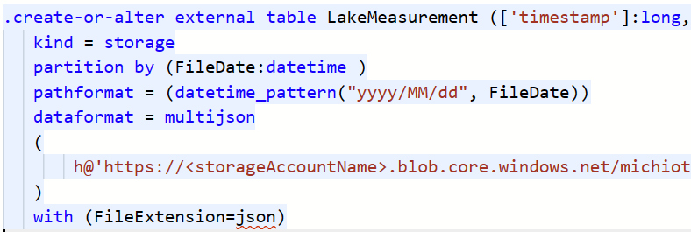
Supported ADX Ingest Paths
Data lake

Slide 4
Supported ADX Ingest Paths
Data lake

Slide 5
Supported ADX Ingest Paths
Data lake

Slide 6
Supported ADX Ingest Paths
Data lake

Slide 7
Supported ADX Ingest Paths
Data lake

Slide 8
Supported ADX Ingest Paths
Data lake

Slide 9
Main Benefits of the toolbox
Huge datasets can be loaded in well defined slices
Slices can be reloaded, if needed
Slices can be loaded parallel (pipeline defines how many parallel loads are executed)
Data transfer workload can scale out over different integration runtimes to optimize performance
If a slice fails, then it can be restarted, without data duplication
Transfer is logged in the meta data database (duration, number of rows transferred)
If an ADX cluster is the target, then creationTime is set correctly and the following tags are added
"PipelineRun_Id:<@pipeline().RunId>"
"LoadedAt:<UTC date of data load>"
"SlicedImportObject_Id:<SlicedImportObject_Id of the slice >"
"ExtentFingerprint:<YYYYMMDD of the slice. Used to identifiy extents from previous loads"
Very simple and cost efficient ADF/Synapse pipelines
No complex logic within the pipelines
Full flexibility to extend and integrate the pipelines, according to the project requirements

Slide 10
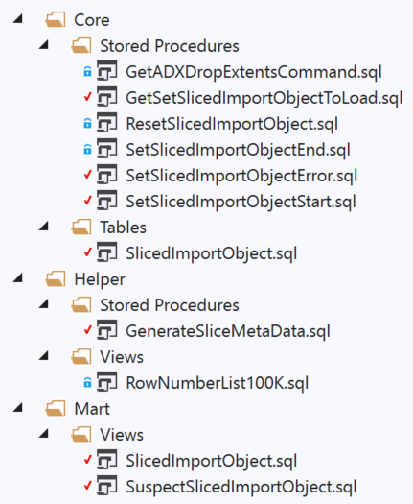

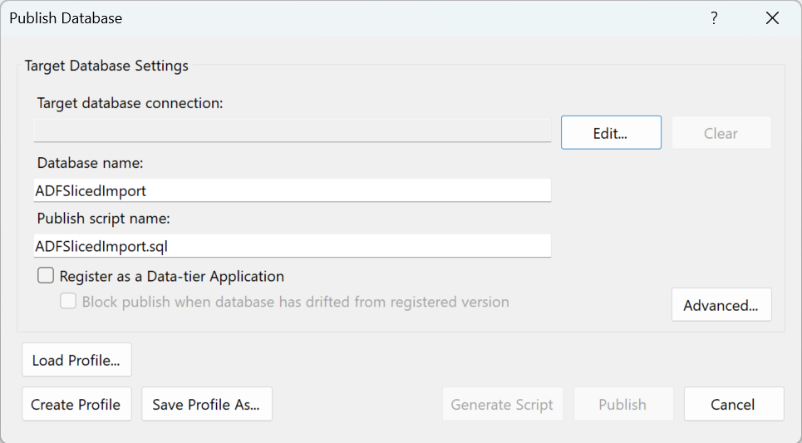
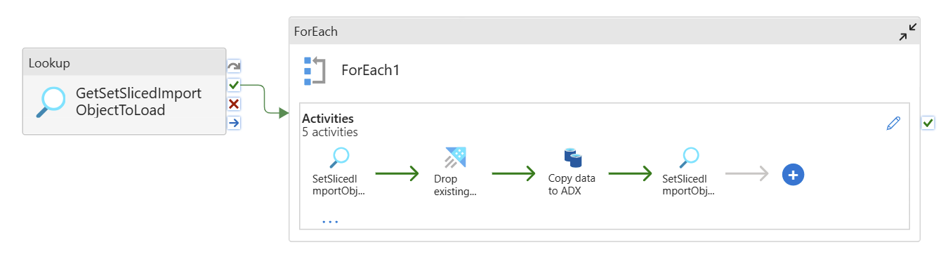
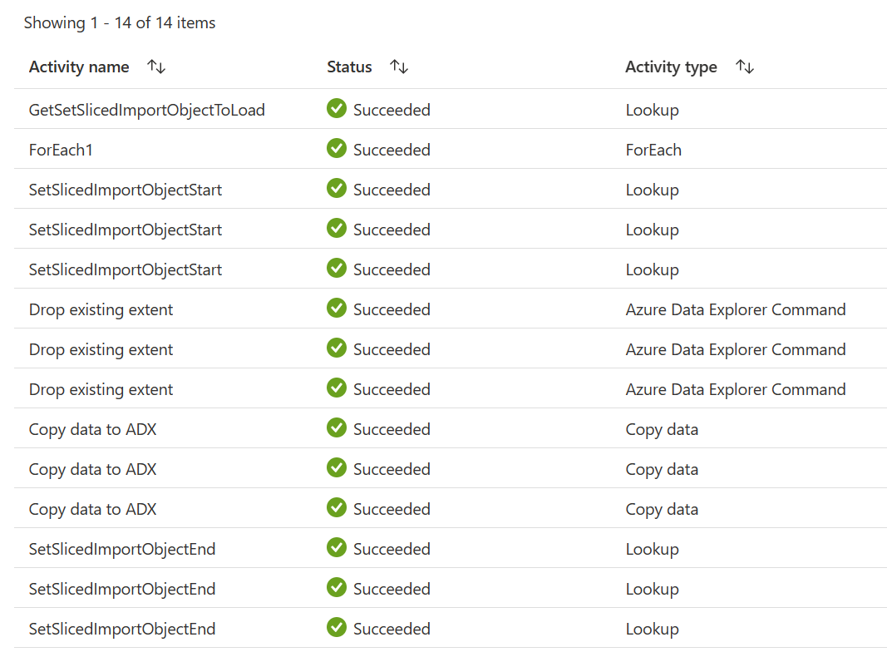
Usage
Download GitHub repo
Deploy meta data database project to an (Azure) SQL DB
Deploy/create ADF/Synapse Pipeline
Generate slice meta data
Run the pipelines
DECLARE @LowWaterMark DATE = '2021-11-25' -- GE
,@HigWaterMark DATE = '2021-11-28' -- LT
,@Resolution VARCHAR(25) = 'Day' -- Day/Month
,@SourceSystemName sysname = 'FatoryEdge'
EXEC [Helper].[GenerateSliceMetaData]
@LowWaterMark = @LowWaterMark
,@HigWaterMark = @HigWaterMark
,@Resolution = @Resolution
,@SourceSystemName = @SourceSystemName
,@SourceSchema = 'Core'
,@SourceObject = 'Measurement'
,@GetDataCommand = 'SELECT * FROM [Core].[Measurement]'
,@DateFilterAttributeName = '[Ts]'
,@DateFilterAttributeType = 'DATETIME2(3)'
,@DestinationObject = ‘Core_Measurement'
Azure/azure-kusto-sdmt: Sliced data migration toolbox (loading historical data to ADX - Kusto) (github.com)
Notes:
Azure/azure-kusto-sdmt: Sliced data migration toolbox (loading historical data to ADX - Kusto) (github.com)

Slide 11

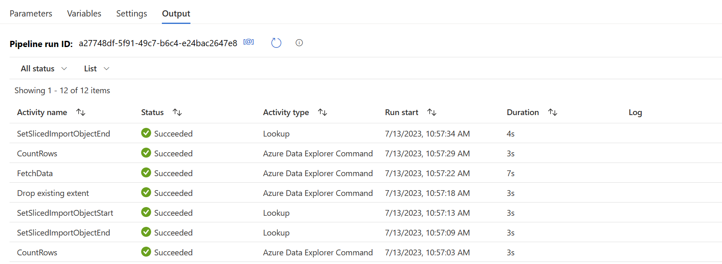

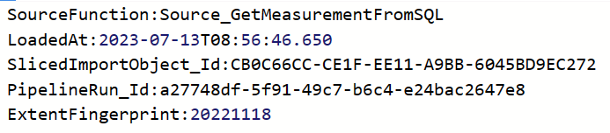
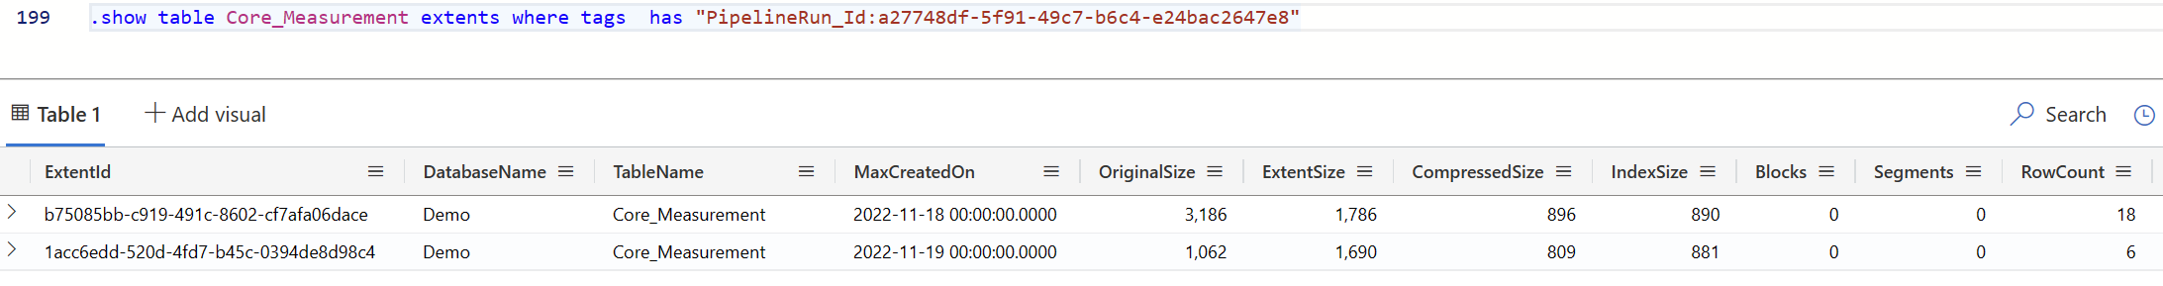

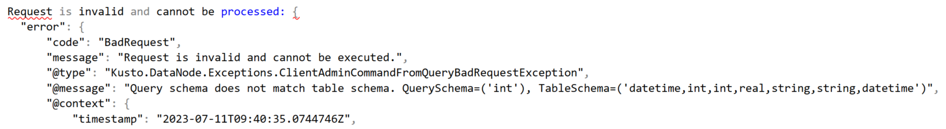
Telemetry Info in ADF, ADX and SQL

Slide 12
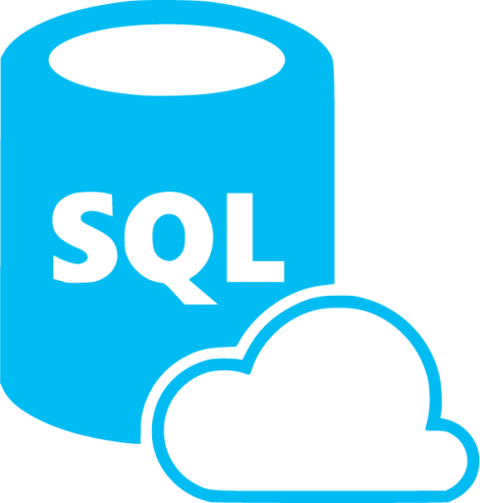
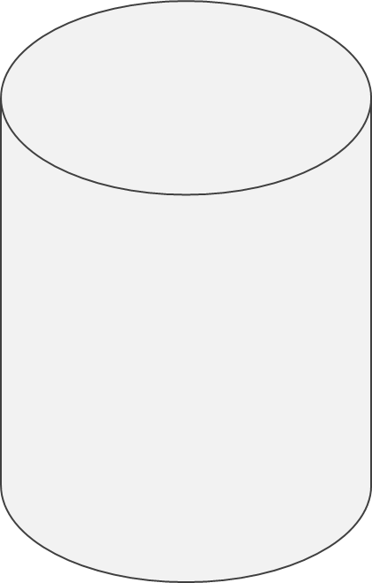

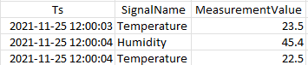

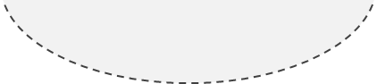
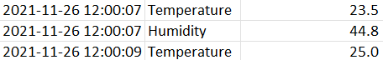
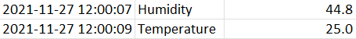
SDMT – Sliced Data Migration Tool - Overview
SMDT Meta Data
ADF/Synapse/Fabric Pipelines
Source (SQL) Database
[Measurement]
[Core].[SlicedImportObject]
Target (ADX/SQL)
Database
[Measurement]
Measurement
2021-11-25
2021-11-26
2021-11-27

Slide 13

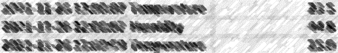
SDMT – Sliced Data Migration Tool – Error slice
SMDT Meta Data
ADF/Synapse Pipelines
Source (SQL) Database
[Measurement]
[Core].[SlicedImportObject]
Target (ADX/SQL)
Database
[Measurement]
Measurement
2021-11-25
2021-11-26
2021-11-27

Slide 14
SDMT – Sliced Data Migration Tool - Restart
SMDT Meta Data
ADF/Synapse Pipelines
Source (SQL) Database
[Measurement]
[Core].[SlicedImportObject]
Target (ADX/SQL)
Database
[Measurement]
Measurement
2021-11-25
Slice Reload
2021-11-26
2021-11-27

Slide 15
SDMT – Sliced Data Migration Tool - ADX
SMDT Meta Data
ADF/Synapse Pipelines
Source (SQL) Database
[Measurement]
[Core].[SlicedImportObject]
Target ADX
Database
[Measurement]
Measurement
{"creationTime": "2021-11-25"
,"tags": ["LoadedAt:2023-05-12T07:51:32.343"
,"SlicedImportObject_Id:4FC9A0…A23E7F7"
,"PipelineRun_Id:04d26153-99…710ca6d2"
,"ExtentFingerprint:20211125"]}
2021-11-25
{"creationTime": "2021-11-26"
,"tags": ["LoadedAt:2023-05-12T07:51:32.343"
,"SlicedImportObject_Id:5FC9A0…A23E7F7"
,"PipelineRun_Id:14d26153-99…710ca6d2"
,"ExtentFingerprint:20211126"]}
2021-11-26
2021-11-27
{"creationTime": "2021-11-27"
,"tags": ["LoadedAt:2023-05-12T07:51:32.343"
,"SlicedImportObject_Id:6FC9A0…A23E7F7"
,"PipelineRun_Id:34d26153-99…710ca6d2"
,"ExtentFingerprint:20211127"]}

Slide 16
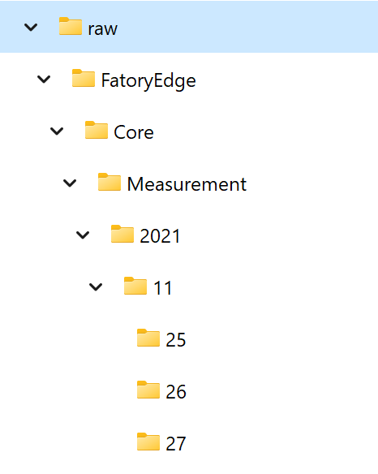
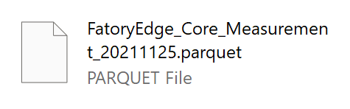
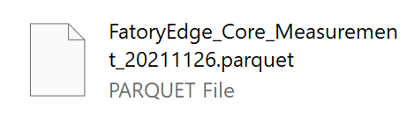
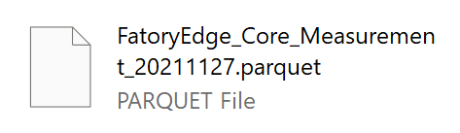
SDMT – Transfer to data lake
SMDT Meta Data
ADF/Synapse Pipelines
Source (SQL) Database
[Measurement]
[Core].[SlicedImportObject]
Measurement
2021-11-25
2021-11-26
2021-11-27

Slide 17
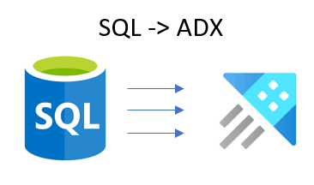

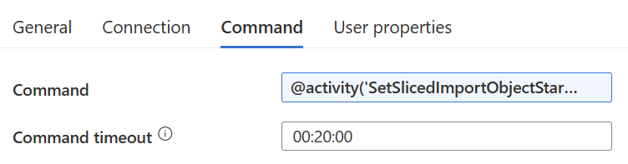
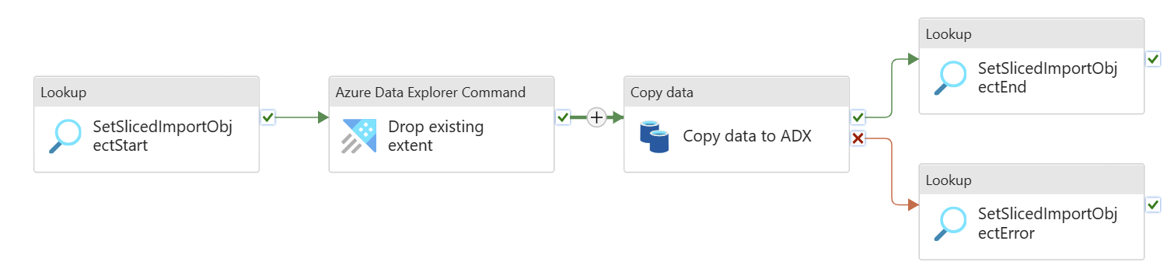
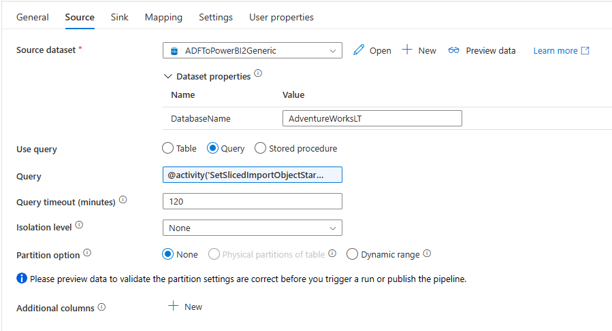
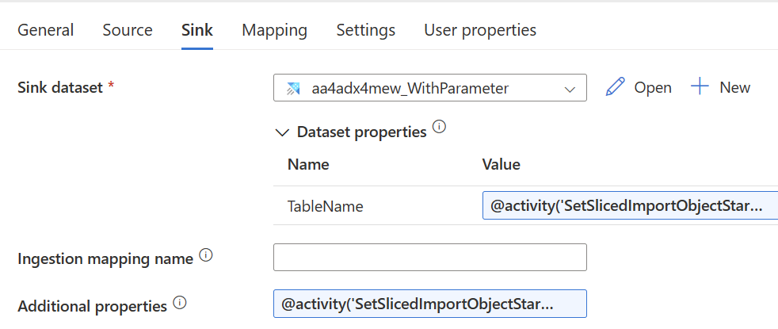
Direct Transfer (SQL -> ADX)
[Core].[SlicedImportObject]
@activity('SetSlicedImportObjectStart') .output.firstRow.ADX_DropExtentCommand
@activity('SetSlicedImportObjectStart') .output.firstRow.DestinationObject
@activity('SetSlicedImportObjectStart’) .output.firstRow.SelectCommand
@activity('SetSlicedImportObjectStart') .output.firstRow.AdditionalContext

Slide 18
Direct Transfer (SQL -> ADX)
[Core].[SlicedImportObject]
.drop extents <| .show table Measurement extents where tags has 'ExtentFingerprint:20211126'
SELECT [Ts], [SignalName], [MeasurementValue]
FROM [Core].[Measurement]
WHERE [Ts] >= CONVERT(DATETIME2(3), '2021-11-26',120)
AND [Ts] < CONVERT(DATETIME2(3), '2021-11-27',120)
{"creationTime": "2021-11-26"
,"tags":["LoadedAt:2023-05-12T07:51:32.343"
,"SlicedImportObject_Id:4FC9A0FF-…A23E7F7"
,"PipelineRun_Id:04d26153-99b6-4…710ca6d2"
,"ExtentFingerprint:20211126"]}
Core_Measurement

Slide 19
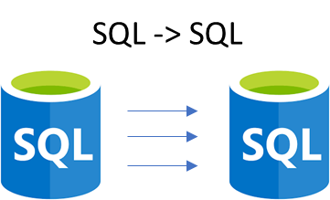
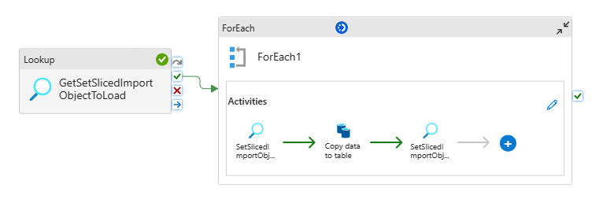
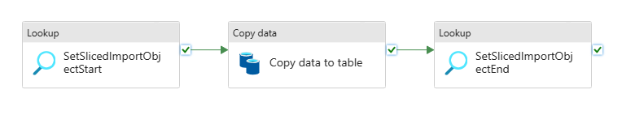
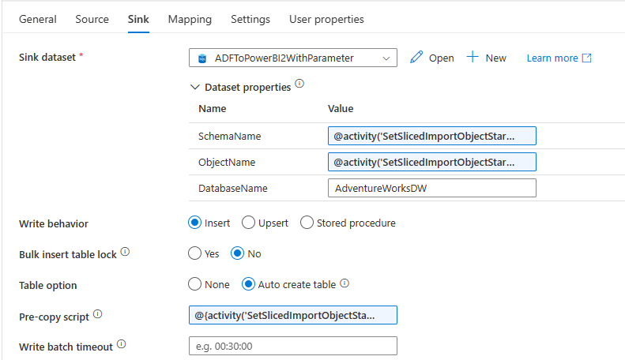
Direct Transfer (SQL -> SQL)
[Core].[SlicedImportObject]
@activity('SetSlicedImportObjectStart’) .output.firstRow.DestinationSchema
@activity('SetSlicedImportObjectStart’) .output.firstRow.SelectCommand
@activity('SetSlicedImportObjectStart’) .output.firstRow.DestinationObject
@{activity('SetSlicedImportObjectStart’) .output.firstRow.EmptyDestinationSliceCommand}

Slide 20
SDMT – via data lake -> ADX
SMDT Meta Data
ADF/Synapse Pipelines
[Core].[SlicedImportObject]
Target ADX
Database
[Measurement]
Measurement
{"creationTime": "2021-11-25"
,"tags": ["LoadedAt:2023-05-12T07:51:32.343"
,"SlicedImportObject_Id:4FC9A0…A23E7F7"
,"PipelineRun_Id:04d26153-99…710ca6d2"
,"ExtentFingerprint:20211125"]}
2021-11-25
{"creationTime": "2021-11-26"
,"tags": ["LoadedAt:2023-05-12T07:51:32.343"
,"SlicedImportObject_Id:5FC9A0…A23E7F7"
,"PipelineRun_Id:14d26153-99…710ca6d2"
,"ExtentFingerprint:20211126"]}
2021-11-26
2021-11-27
{"creationTime": "2021-11-27"
,"tags": ["LoadedAt:2023-05-12T07:51:32.343"
,"SlicedImportObject_Id:6FC9A0…A23E7F7"
,"PipelineRun_Id:34d26153-99…710ca6d2"
,"ExtentFingerprint:20211127"]}

Slide 21
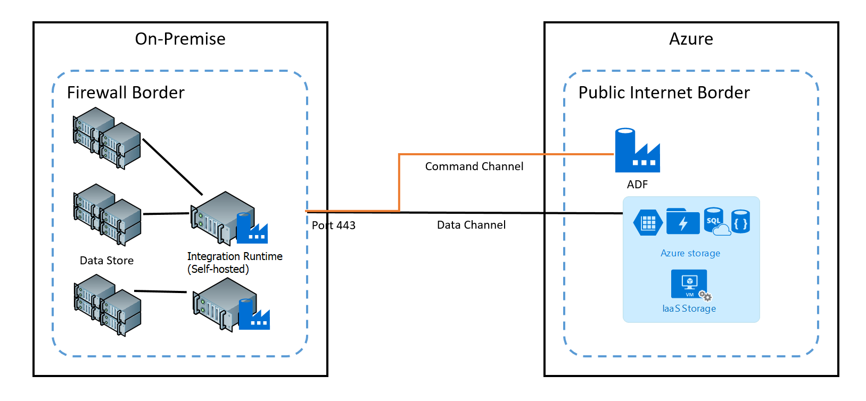
Benefit of using ADF/Synapse Pipelines
Slices can be loaded in parallel
ADF can control if desired and how many parallel sessions make sense
ADF can bridge the gap between on-premises environments and Azure in a secure way, using the self hosted integration runtime
Process can be integrated in a broader ETL process
Detailed runtime statistics

Slide 22

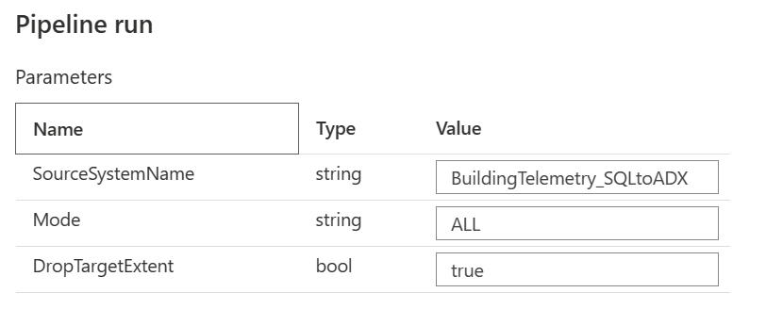
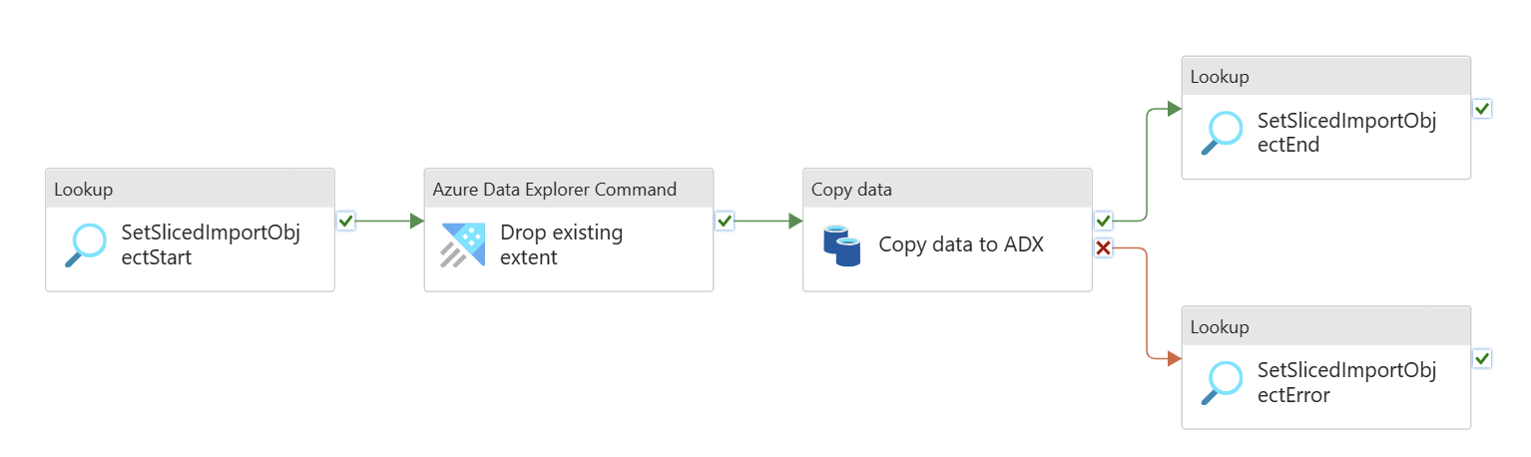


Meta Data Process Flow
REGULAR -> [LastStart] IS NULL
RESTART -> [LastStart] IS NOT NULL AND [LastSuccessEnd] IS NULL
ALL -> Take all slices

Slide 23
Scenarios and required objects/meta data
SQL/Data lake -> ADX
SQL to ADX using ADF copy activity
SQL to ADX, via data lake using ADF copy activity
SQL to ADX using ADX sql_request plugin
Data lake to ADX using ADX external table

Slide 24
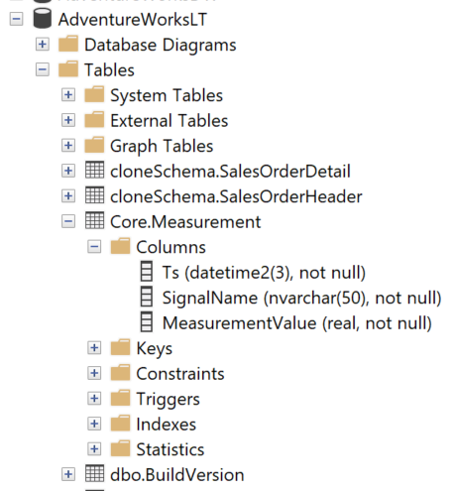
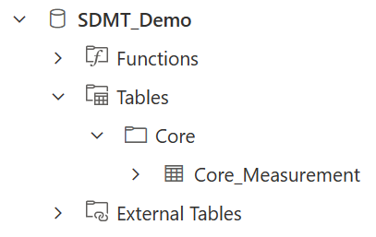
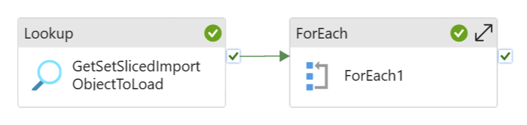
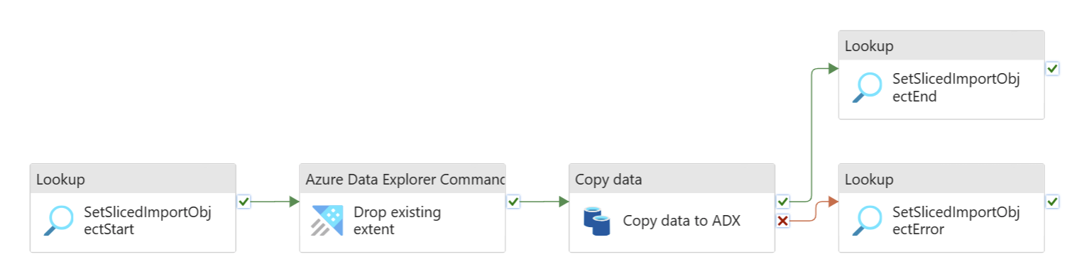
SQL to ADX – Select * from source
SMDT Meta Data
SQL Source
ADX Destination
DECLARE @LowWaterMark DATE = '2021-11-25' -- GE
,@HigWaterMark DATE = '2021-11-28' -- LT
,@Resolution VARCHAR(25) = 'Day'
,@SourceSystemName sysname = 'SQLToADX_CopyActivity'
EXEC [Helper].[GenerateSliceMetaData]
@LowWaterMark = @LowWaterMark
,@HigWaterMark = @HigWaterMark
,@Resolution = @Resolution
,@SourceSystemName = @SourceSystemName
,@SourceSchema = 'Core’
,@SourceObject = 'Measurement’
,@DateFilterAttributeName = '[Ts]'
,@DateFilterAttributeType = 'DATETIME2(3)'
,@DestinationObject = 'Core_Measurement'

Slide 25
SQL to ADX – Specify select statement
SMDT Meta Data
SQL Source
ADX Destination
DECLARE @LowWaterMark DATE = '2021-11-25' -- GE
,@HigWaterMark DATE = '2021-11-28' -- LT
,@Resolution VARCHAR(25) = 'Day'
,@SourceSystemName sysname = 'SQLToADX_CopyActivity'
EXEC [Helper].[GenerateSliceMetaData]
@LowWaterMark = @LowWaterMark
,@HigWaterMark = @HigWaterMark
,@Resolution = @Resolution
,@SourceSystemName = @SourceSystemName
,@GetDataCommand = 'SELECT [Ts],[SignalName],[MeasurementValue] FROM [Core].[Measurement]’
,@DateFilterAttributeName = '[Ts]'
,@DateFilterAttributeType = 'DATETIME2(3)'
,@DestinationObject = 'Core_Measurement'

Slide 26
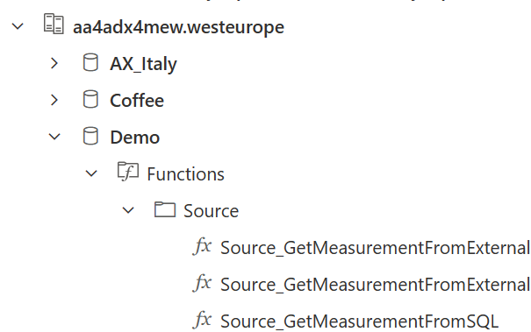
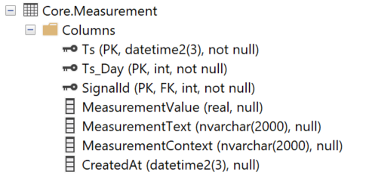
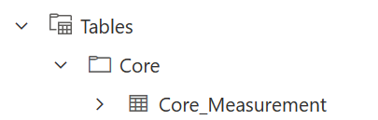
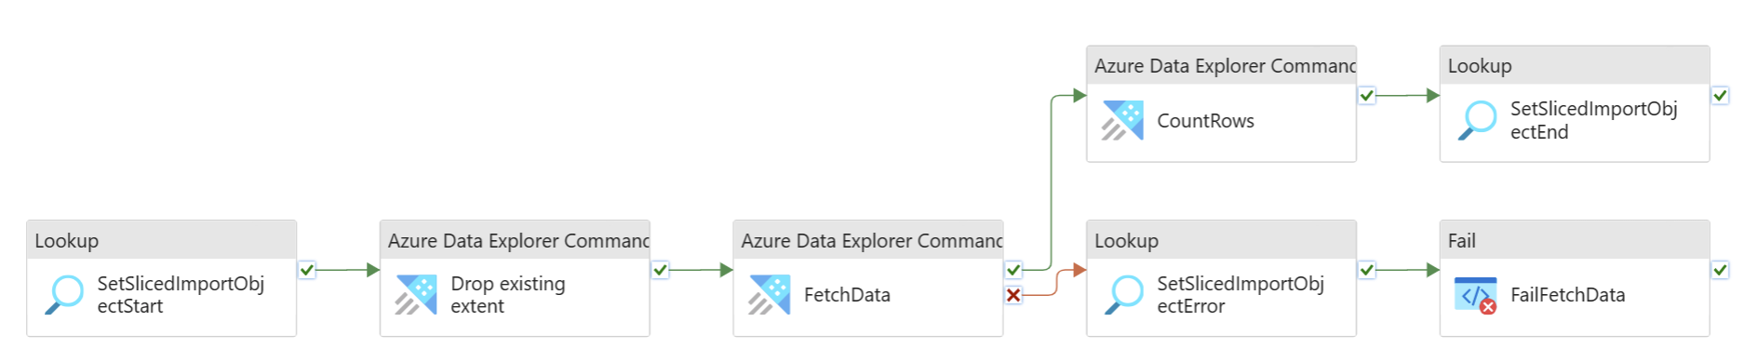
SQL to ADX, using sql_request plugin
SMDT Meta Data
SQL Source
ADX Destination
DECLARE @LowWaterMark DATE = '2022-11-18' -- GE
,@HigWaterMark DATE = '2022-11-20' -- LT
,@Resolution VARCHAR(25) = 'Day' -- Day/Month
,@SourceSystemName sysname = 'SQLtoADXusingADXFetch'
EXEC [Helper].[GenerateSliceMetaData]
@LowWaterMark = @LowWaterMark
,@HigWaterMark = @HigWaterMark
,@Resolution = @Resolution
,@SourceSystemName = @SourceSystemName
,@SourceSchema = 'Core'
,@SourceObject = 'Measurement'
,@GetDataADXCommand = 'Source_GetMeasurementFromSQL'
,@DestinationObject = 'Core_Measurement'
ADX Destination

Slide 27
SQL to ADX, using sql_request plugin
SQL Source
.create-or-alter function with
(folder='Source’
,docstring='Get Measurement data from a SQL Server Database’)
Source_GetMeasurementFromSQL(Ts_Day: string)
{
let tbl =
evaluate
sql_request('Server=tcp:<serverURL;Authentication="Active Directory Integrated"
;Initial Catalog=<databaseName>',
strcat('select * from Core.Measurement
where Ts_Day = ', Ts_Day))
: (Ts: datetime, Ts_Day: int, SignalId: int , MeasurementValue: real, MeasurementText: string, MeasurementContext: string
, CreatedAt: datetime)
;
tbl
}
ADX Destination

Slide 28
SQL to ADX, using sql_request plugin
SMDT Meta Data
SQL Source
ADX Destination
"firstRow": {
"ADXFetchCommand": ".set-or-append Core_Measurement with (creationTime='2023-06-27’, tags='[\"LoadedAt:2023-07-11T09:48:09.433\«
,\"SlicedImportObject_Id:211B15C1-A81C-EE11-A9BB-6045BD9EC272\«
,\"PipelineRun_Id:040fdeb5-a201-4e29-8a3e-7f8bc979bfe0\«
,\"ExtentFingerprint:20230627\«
,\"SourceFunction:Source_GetMeasurementFromExternalMeasurement\"]') <|
Source_GetMeasurementFromExternalMeasurement(20230627)",
"ADXDropExtentCommand": ".drop extents <| .show table Core_Measurement extents
where tags has 'ExtentFingerprint:20230627'",
"ADXCountRowsInExtentCommand": ".show table Core_Measurement extents
where tags has 'PipelineRun_Id:040fdeb5-a201-...c979bfe0’
abd tags has 'ExtentFingerprint:20230627’
| summarize RowCount=sum(RowCount)",
}
2
1
3
3
1
2

Slide 29

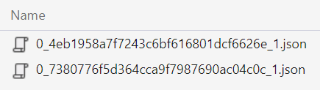
Data lake to ADX, using external table
.create-or-alter external table Source_ExternalMeasurement (['timestamp']:long ,['values']:dynamic
,['EventProcessedUtcTime']:datetime
,['PartitionId']:int
,['EventEnqueuedUtcTime']:datetime
,['IoTHub']:dynamic)
kind=storage
partition by (FileDate:datetime)
pathformat = (datetime_pattern("yyyy/MM/dd", FileDate))
dataformat = multijson
(
h@'abfss://<container>@<storageAccount>.dfs.core.windows.net/<Folder>;impersonate'
)
with (FileExtension=json, folder='Source')
Data lake
ADX Destination
.create-or-alter function Source_GetMeasurementFromExternalMeasurement(Ts_Day: string)
{
external_table('Source_ExternalMeasurement’)
| where FileDate == Ts_Day
| extend msg_IoTHub_ConnectionDeviceId=['IoTHub']['ConnectionDeviceId’] ,msg_IoTHub_EnqueuedTime=['IoTHub']['EnqueuedTime’]
| mv-expand bagexpansion=array values
| extend timestamp, values.id, values.v, values.q, values.t
... | project Ts, Ts_Day, SignalId,MeasurementValue, MeasurementText, MeasurementContext,CreatedAt
}

Slide 30

Data lake to ADX, using external table
SMDT Meta Data
Data lake
ADX Destination
DECLARE @LowWaterMark DATE = '2022-11-18' -- GE
,@HigWaterMark DATE = '2022-11-20' -- LT
,@Resolution VARCHAR(25) = 'Day' -- Day/Month
,@SourceSystemName sysname = 'SQLtoADXusingADXFetch'
EXEC [Helper].[GenerateSliceMetaData]
@LowWaterMark = @LowWaterMark
,@HigWaterMark = @HigWaterMark
,@Resolution = @Resolution
,@SourceSystemName = @SourceSystemName
,@SourceSchema = 'Core'
,@SourceObject = 'Measurement'
,@GetDataADXCommand = 'Source_GetMeasurementFromExternalMeasurement'
,@DestinationObject = 'Core_Measurement'
ADX Destination

Slide 31
Asks
General Feedback
Migrate the code to “official” Git Repo
Automate Deployment
Documentation changes

Slide 32
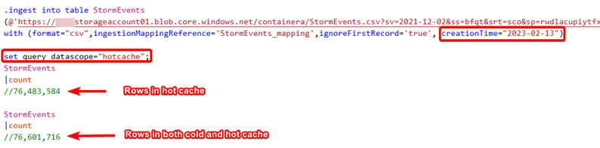
Open points
General feedback
Useful tags
“load command” controlled from ADX if data is landed in the data lake
Only single day make sense?

Slide 33
Points to discuss
{"creationTime": "2021-11-25"
,"tags": ["LoadedAt:2023-05-12T07:51:32.343"
,"SlicedImportObject_Id:4FC9A0…A23E7F7"
,"PipelineRun_Id:04d26153-99…710ca6d2"
,"ExtentFingerprint:20211125"]}
{"creationTime": "2021-11-25",
"tags":
["Source:PipelineLoad",
"LoadedAt:2023-05-04T05:24:10.583",
"SlicedImportObject_Id:6DD4A13A-…-BF79"]
}
General feedback
Useful tags
Use “.ingest command” -> controlled from ADX if data is landed in the data lake
Less expensive
Better performance
“No” control on the meta data side, if used with [async]
No wildcards
I assume, for AdX only single day slices make sense?
.ingest [async] into table Measurement
h'https://xxx.blob.core…./slicedimport/raw…/FatoryEdge_Core_ent…_20211125.parquet;managed_identity=system'
with (format='parquet')
Notes:
.ingest into table Measurement
h'https://newmewsynapse.blob.core.windows.net/slicedimport/raw/FatoryEdge/Core/Measurement/2021/11/25/FatoryEdge_Core_Measurement_20211125.parquet;managed_identity=system'
with (format='parquet’)
.create table ['Measurement'] ingestion parquet mapping 'Measurement_mapping' '[{"column":"Ts", "Properties":{"Path":"$[\'Ts\']"}},{"column":"SignalName", "Properties":{"Path":"$[\'SignalName\']"}},{"column":"MeasurementValue", "Properties":{"Path":"$[\'MeasurementValue\']"}}]'

Slide 34
Sliced Data Migration Toolbox (SDMT)
Meinrad Weiss Senior Cloud Solution Architect Microsoft

Slide 35




ChatGPT

Slide 36


Can you please list the input parameter the following stored procedure Id just like to get a table with the parameters (name, data type, default value, purpose). The table should be formatted as a raw MD table.
| Parameter Name | Data Type | Default Value | Purpose |
| --- | --- | --- | --- |
| @LowWaterMark | DATE | '2022.01.01' | The lower bound of the date range to generate slices for. |
| @HigWaterMark | DATE | '2022.03.01' | The upper bound of the date range to generate slices for. |
| @Resolution | VARCHAR(25) | 'day' | The resolution of the slices to generate. Can be 'day' or 'month'. |
| @SourceSystemName | sysname | NULL | The name of the source system. |
| @SourceSchema | sysname | NULL | The name of the source schema. |
| @SourceObject | sysname | NULL | The name of the source object. |
| @GetDataCommand | nvarchar(max) | NULL | The command to retrieve data from the source object. |
| @DateFilterAttributeName | sysname | NULL | The name of the date filter attribute. |
| @DateFilterAttributeType | sysname | NULL | The data type of the date filter attribute. |
| @DestinationSchema | sysname | NULL | The name of the destination schema. |
| @DestinationObject | sysname | NULL | The name of the destination object. |
| @ContainerName | sysname | NULL | The name of the container to store the slices in. |
| @AlternativeRootFolder | sysname | NULL | If provided, then this value is used instead of the @SourceSystemName to create the directory path. |
| @MaxRowsPerFile | int | NULL | The maximum number of rows to include in each slice file. |
| @IngestionMappingName | sysname | NULL | The name of the ingestion mapping to use. |
Can you please generate the raw MD?

Slide 37

Generate Meta Data
DECLARE @LowWaterMark DATE = '2002-06-01' -- GE
,@HigWaterMark DATE = '2002-08-01' -- LT 05
,@Resolution VARCHAR(25) = 'Month' -- Day/Month
,@SourceSystemName sysname = 'AdventureWorksLTXXX'
,@ContainerName sysname = 'adftopowerbi'
EXEC [Helper].[GenerateSliceMetaData]
@LowWaterMark = @LowWaterMark
,@HigWaterMark = @HigWaterMark
,@Resolution = @Resolution
,@SourceSystemName = @SourceSystemName
,@SourceSchema = 'SalesLT'
,@SourceObject = 'MeasurementX'
,@GetDataCommand = 'SELECT [MeasurementID], [Name], [MeasurementNumber], [Color], [SellStartDate] FROM [SalesLT].[MeasurementX]'
,@DateFilterAttributeName = '[SellStartDate]'
,@DateFilterAttributeType = 'DATETIME'
,@DestinationSchema = 'SalesLT_SDMT'
,@DestinationObject = 'Measurement'
,@ContainerName = @ContainerName
,@AlternativeRootFolder = NULL
,@MaxRowsPerFile = 10
select *
from Core.SlicedImportObject
where SourceSystemName = 'AdventureWorksLTXXX'

Slide 38

Generate Meta Data
DECLARE @LowWaterMark DATE = '2002-06-01' -- GE
,@HigWaterMark DATE = '2002-08-01' -- LT 05
,@Resolution VARCHAR(25) = 'Day' -- Day/Month
,@SourceSystemName sysname = 'AdventureWorksLTXXX'
,@ContainerName sysname = 'adftopowerbi'
EXEC [Helper].[GenerateSliceMetaData]
@LowWaterMark = @LowWaterMark
,@HigWaterMark = @HigWaterMark
,@Resolution = @Resolution
,@SourceSystemName = @SourceSystemName
,@SourceSchema = 'SalesLT'
,@SourceObject = 'MeasurementX'
,@GetDataCommand = 'SELECT [MeasurementID], [Name], [MeasurementNumber], [Color], [SellStartDate] FROM [SalesLT].[MeasurementX]'
,@DateFilterAttributeName = '[SellStartDate]'
,@DateFilterAttributeType = 'DATETIME'
,@DestinationSchema = 'SalesLT_SDMT'
,@DestinationObject = 'Measurement'
,@ContainerName = @ContainerName
,@AlternativeRootFolder = NULL
,@MaxRowsPerFile = 10
select *
from Core.SlicedImportObject
where SourceSystemName = 'AdventureWorksLTXXX'

Slide 39
Manual Meta Data
INSERT INTO [Core].[SlicedImportObject]
([SlicedImportObject_Id]
,[SourceSystemName]
,[SourceSchema]
,[SourceObject]
,[GetDataCommand]
,[FilterDataCommand]
,[DestinationSchema]
,[DestinationObject]
,[ContainerName]
,[DestinationPath]
,[DestinationFileName]
,[MaxRowsPerFile]
)
VALUES
('37C8B38B-B913-4593-B1F2-68EDCB5DC60F'
,'AdventureWorksLT'
,'SalesLT'
,'SalesOrderHeader'
,'SELECT [SalesOrderID], [RevisionNumber], [OrderDate], [Status] FROM [SalesLT].[SalesOrderHeader]'
,'WHERE [SalesOrderID] < 71815'
,'AdventureWorksLT_SalesLT_Sliced'
,'SalesOrderHeader'
,'adf-to-powerbi'
,'raw/SlicedImport/AdventureWorksLT/SalesLT/SalesOrder/SalesOrderID_lt71815'
,'SalesOrderHeader_lt71815'
,5
);

Slide 40

Migration Path’s and Performance
SELECT TOP 10000000 Measurement.*
FROM Core.Measurement
CROSS JOIN core.signal
WHERE ts_day = 20221209
SQL -> (data lake) -> ADX
ADF/Synapse Copy activity
ADX “read request”
External Table
sql_request()

